Slide 1
Mob Programming

Slide 2
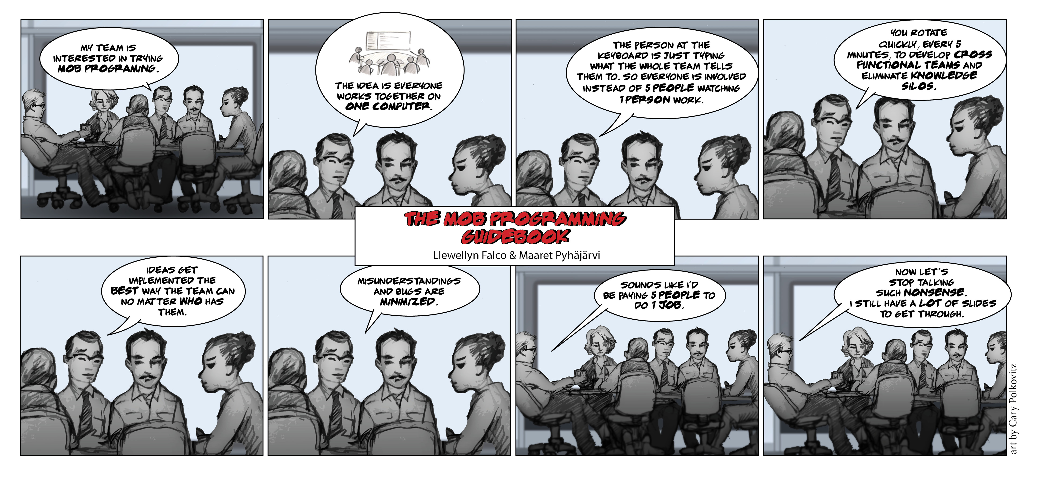

Slide 11
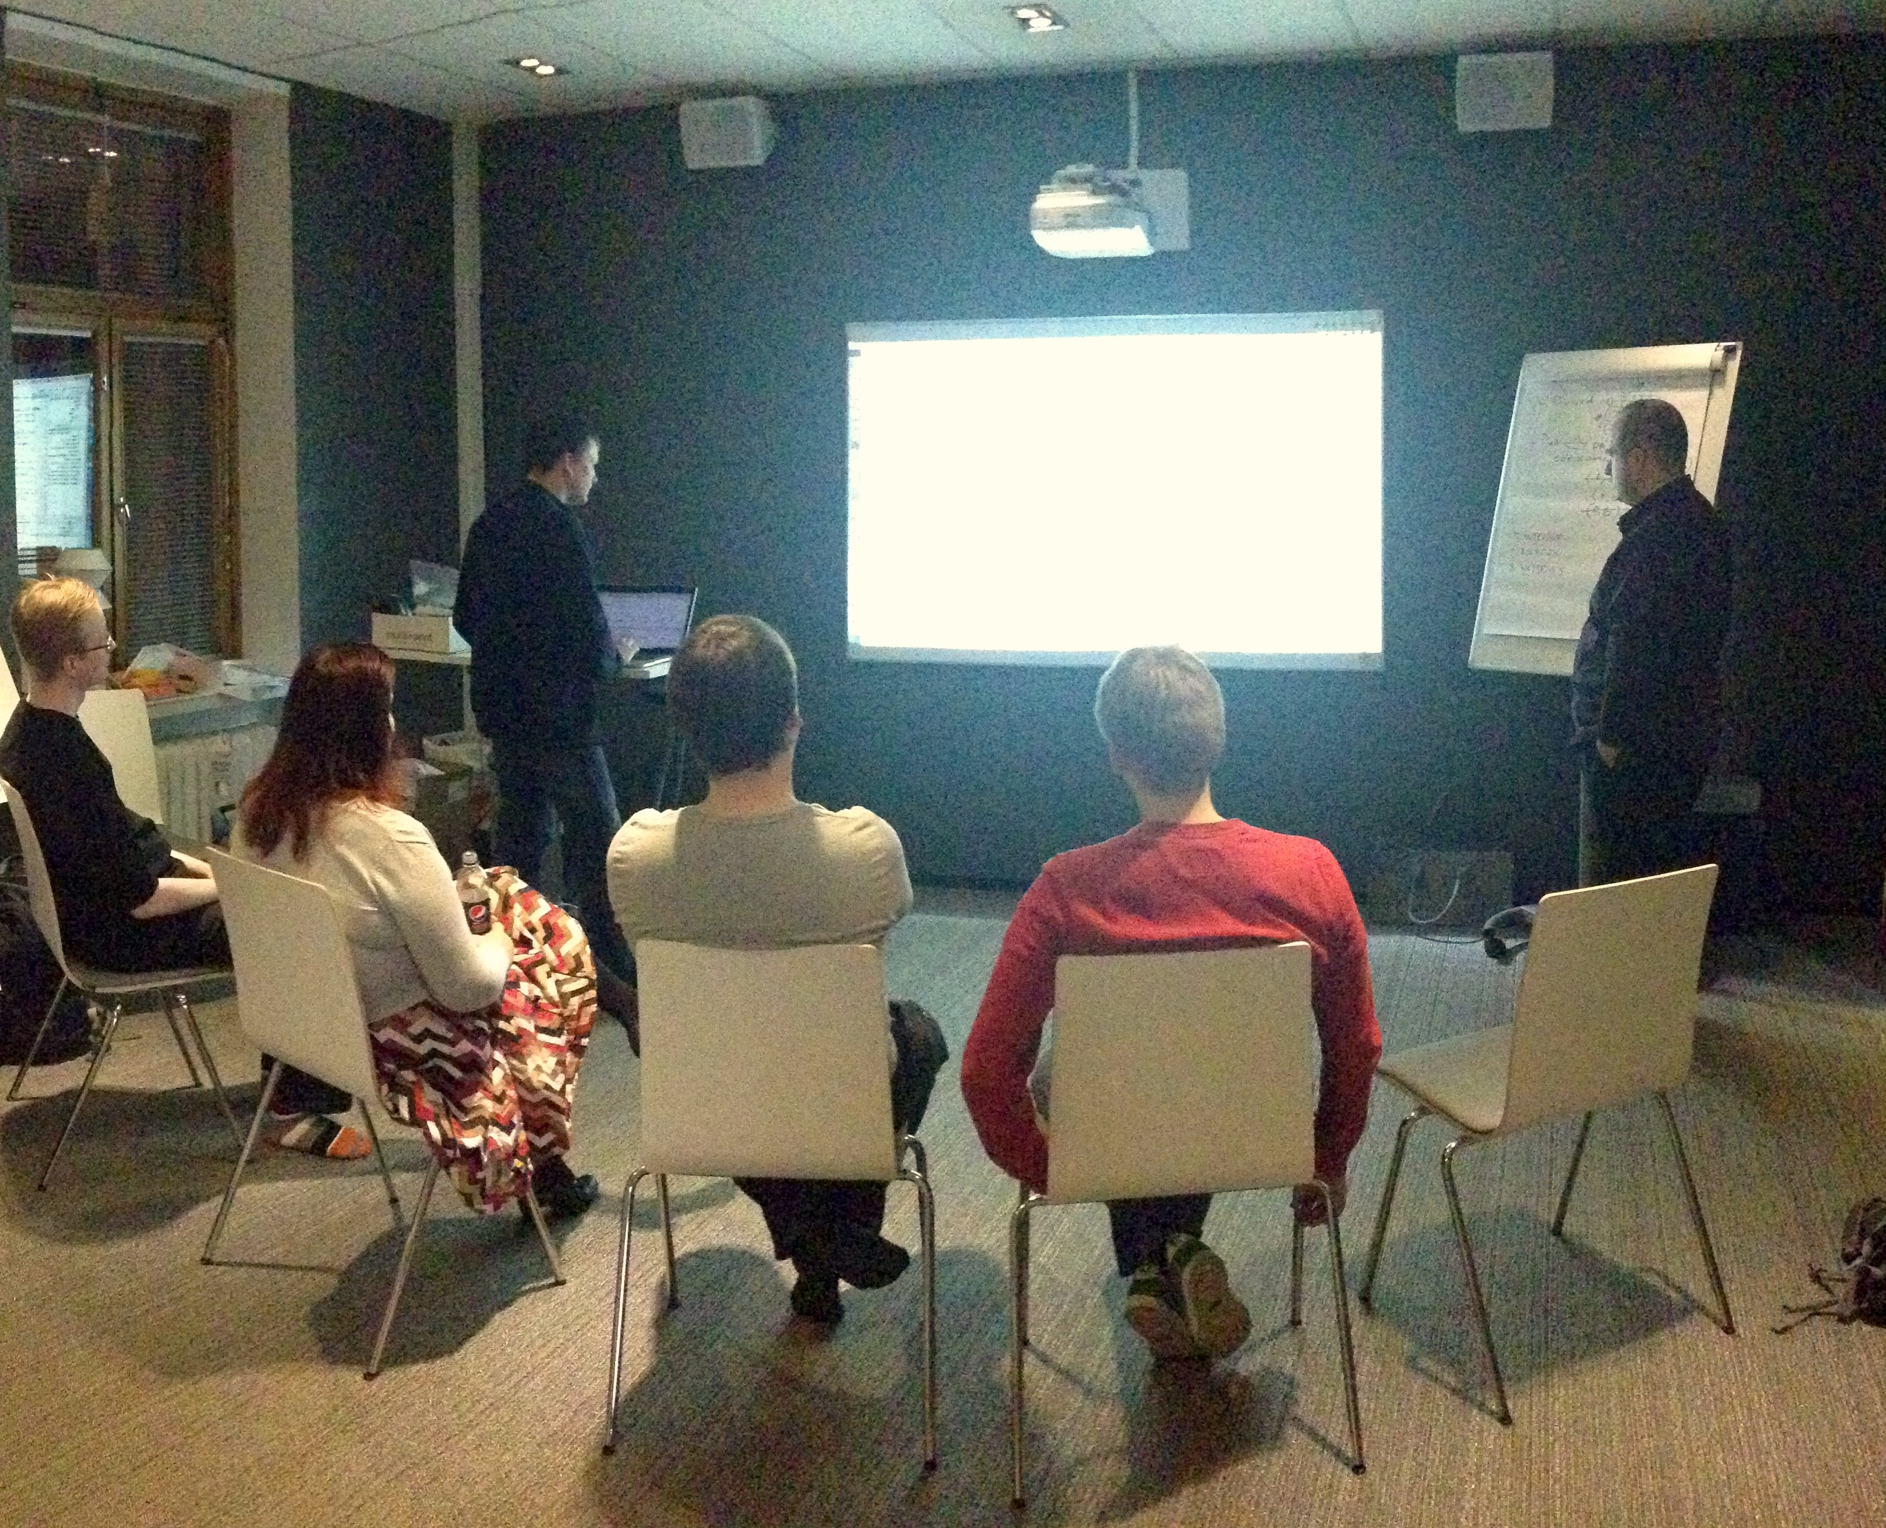

Slide 12
"All the brilliant people working on the same thing, at the same time, in the same space, on the same computer." -- Woody Zuill

Slide 13
Mobbing Basics

Slide 14
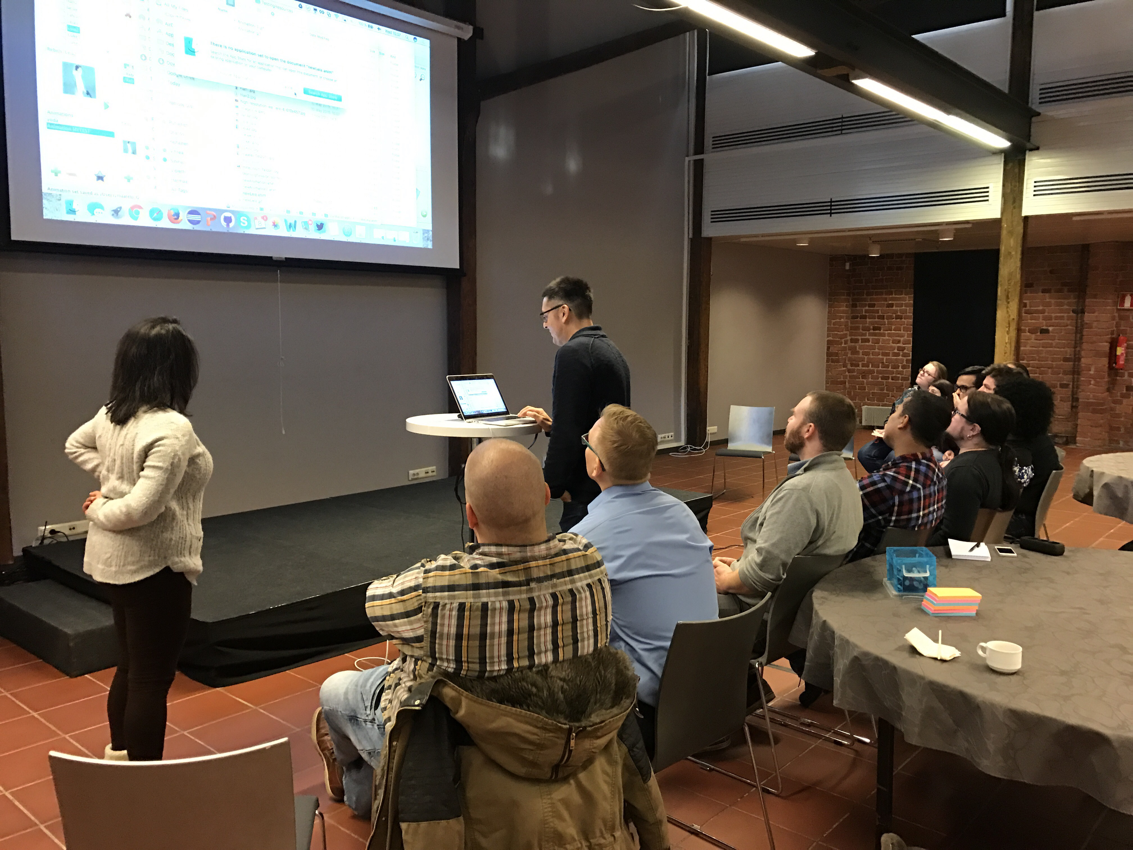
Driver (no thinking)

Slide 15
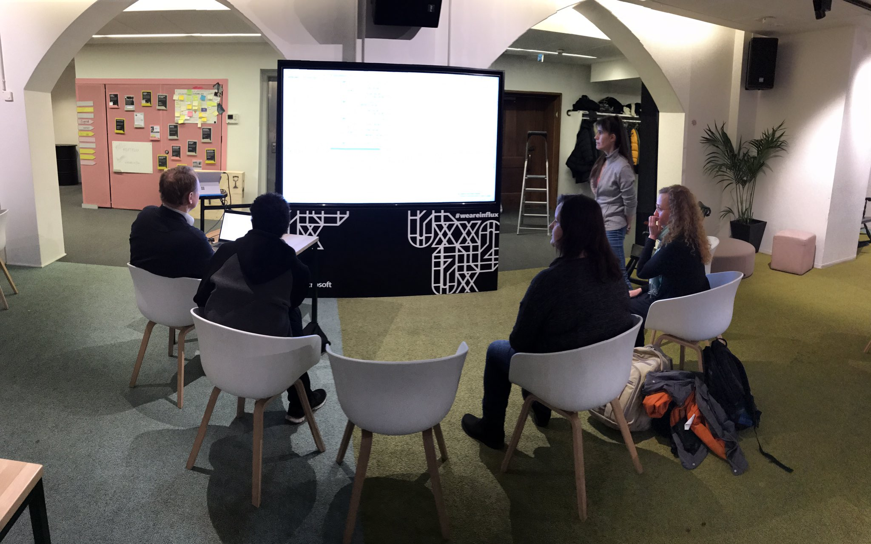
(Designated)
Navigator
Notes:
Talk about introverts

Slide 16
Highest level of abstraction Intent Location Details

Slide 17
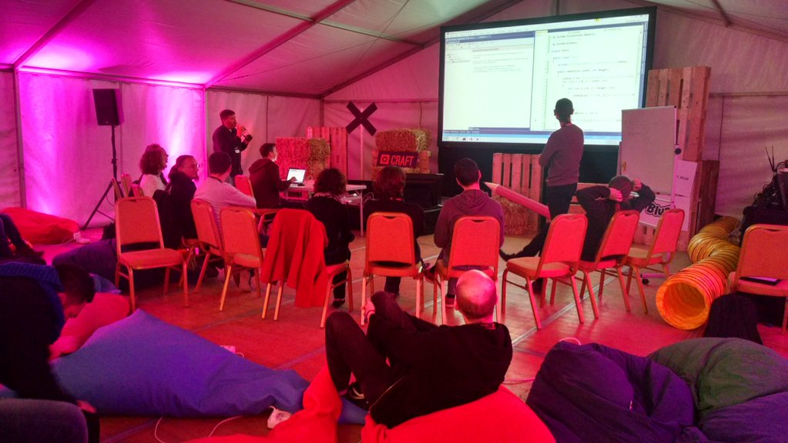
4 minutes

Slide 18
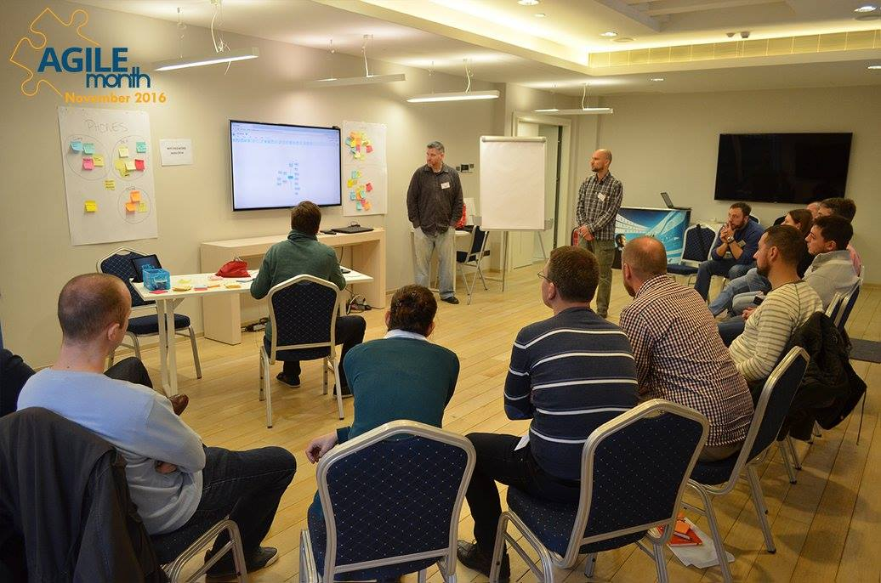
Retrospectives

Slide 19
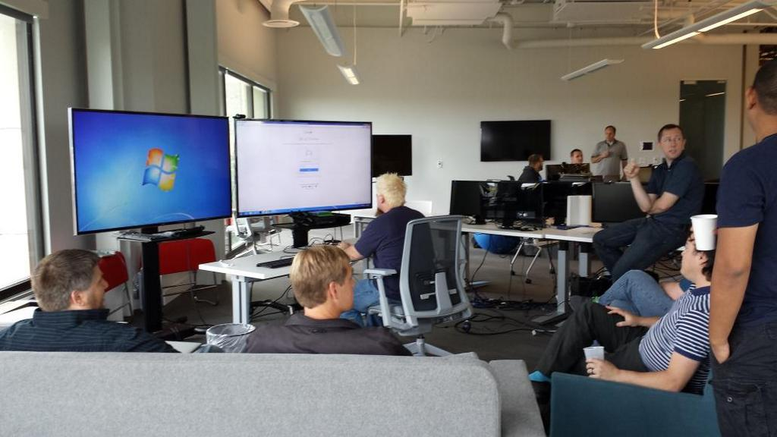
If everyone is contributing or learning
it’s the right size

Slide 20
Kindness Consideration & Respect

Slide 21
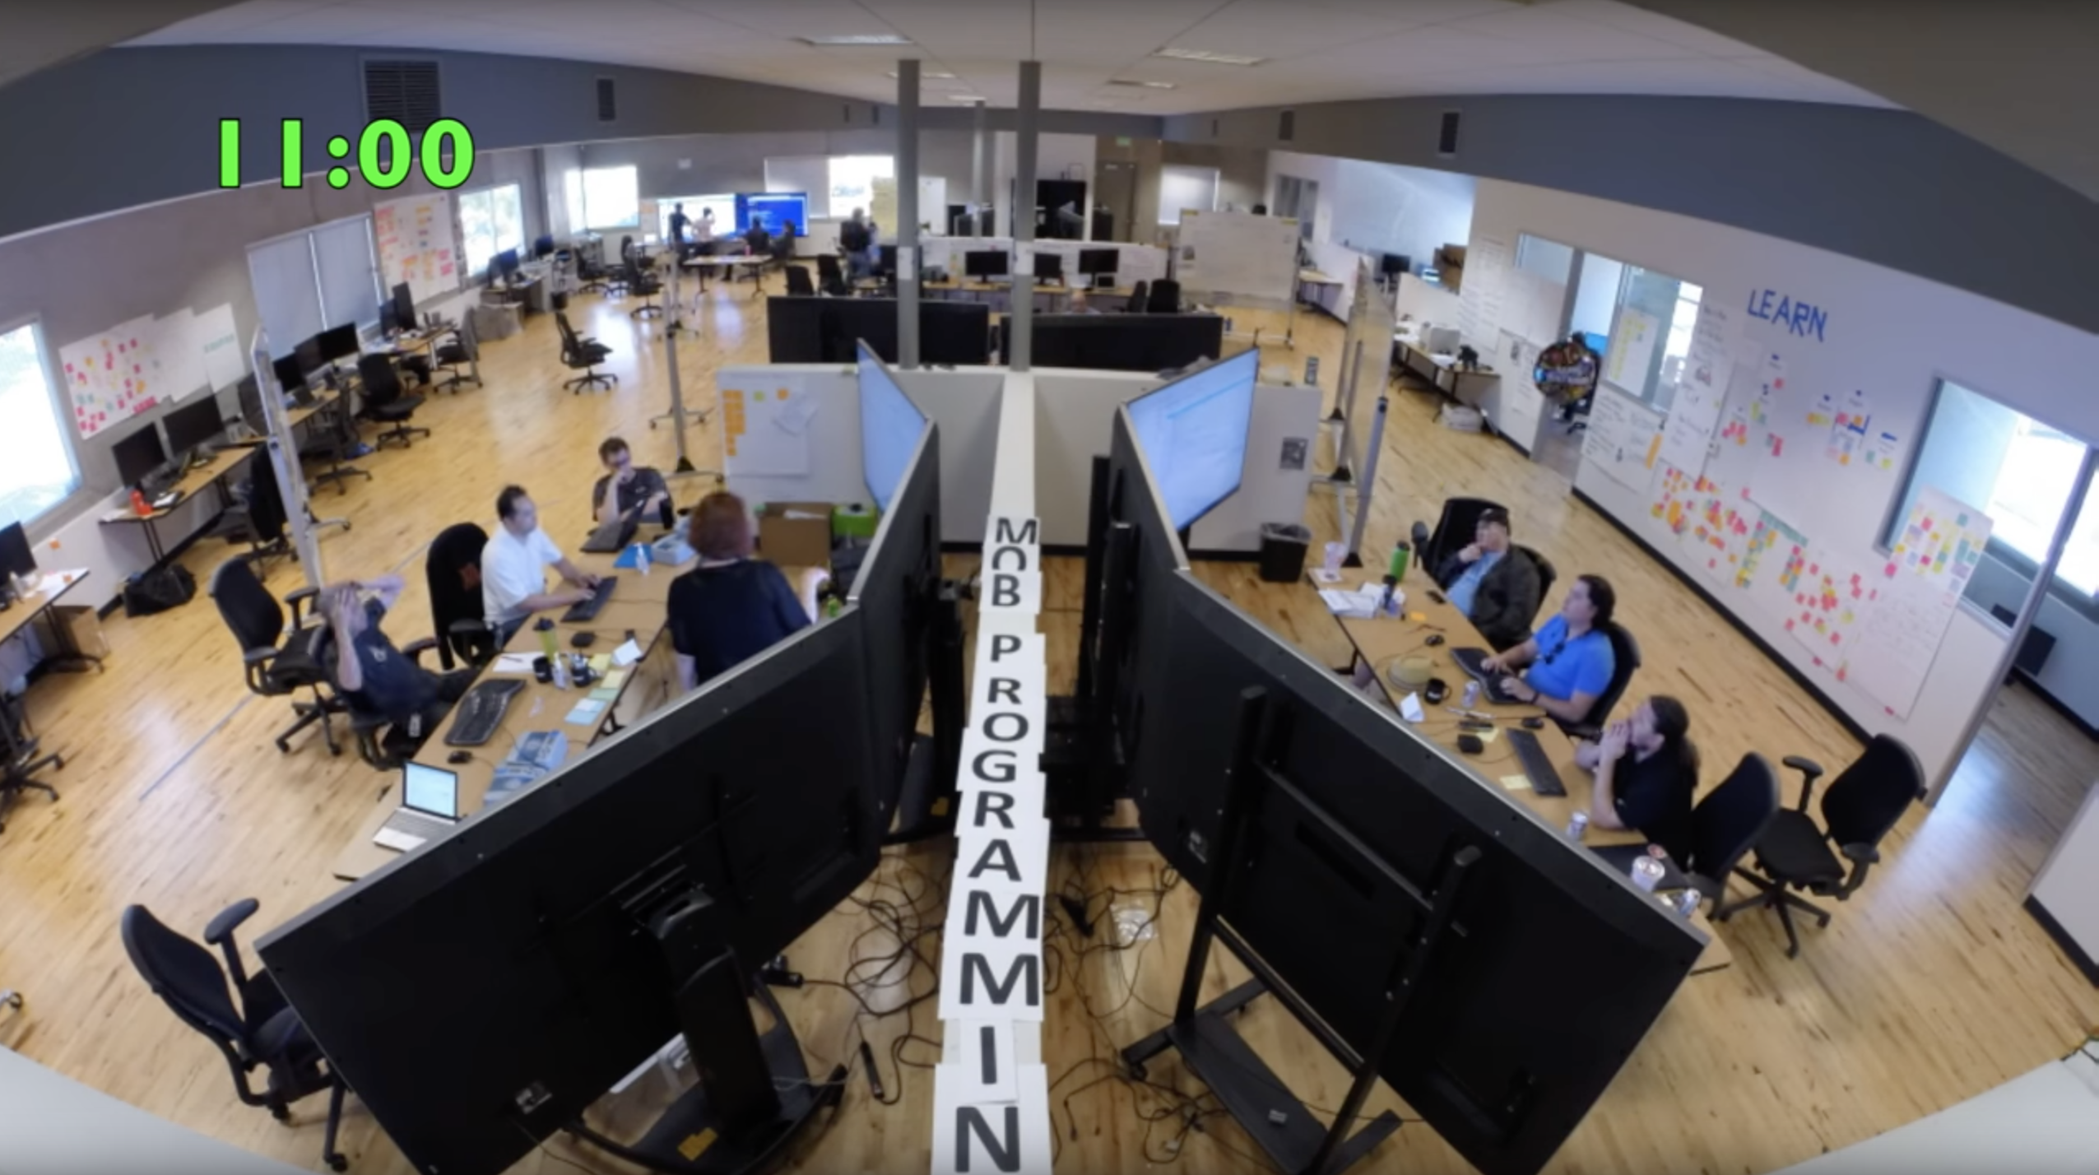
2 Ideas? Try Both!

Slide 22
The best ideas win when we care about work over credit

Slide 23
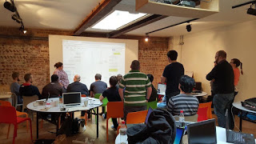
Learning

Slide 24
On being the best…
I know more than you do!
There is still so much more I can learn from you
I know everything you do!
You have nothing left to teach me
vs.
Linear Viewpoint
Reality

Slide 25
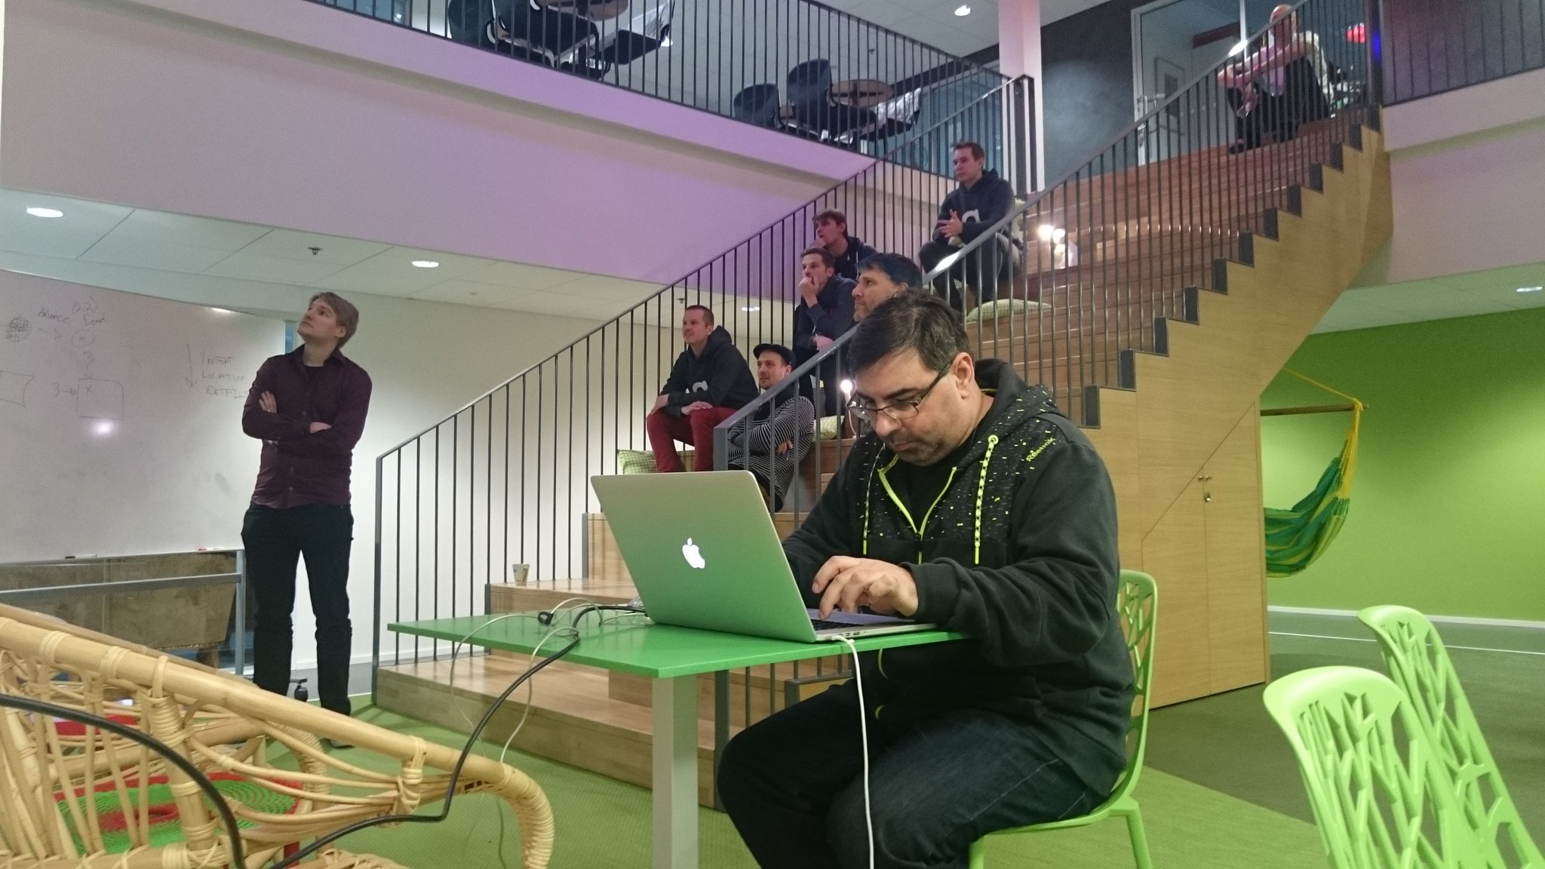
Why does this work?

Slide 26
"Division of labor is a dangerous fiction when all of your big problems are integration problems” - @KentBeck

Slide 27
Sometimes I’m GOOD
Quality

Slide 28
Sometimes I’m NOT
Quality

Slide 29
My BEST and my WORST
Make it into the work
Quality

Slide 30
Separate

Slide 31
Quality
Our BEST and our WORST
Make it into the work

Slide 32
Pairing

Slide 33
Quality

Slide 34
Quality

Slide 35
Our BEST
Makes it into the work
Quality

Slide 36
Mobbing

Slide 37
Quality

Slide 38
Quality

Slide 39
Quality

Slide 40
Quality
The BEST of the whole team
makes it into the work

Slide 41
When you mob
Hard problem ➔ Solution
Easy problem ➔ Innovation

Slide 42
“If you were mobbing you wouldn’t have these problems…”

Slide 43
Problems that just
Disappear…

Slide 44
Meetings

Slide 45
Merg
&
ing
Branch
ing

Slide 46
Knowledge loss

Slide 47
First day on the job

Slide 48


Slide 49
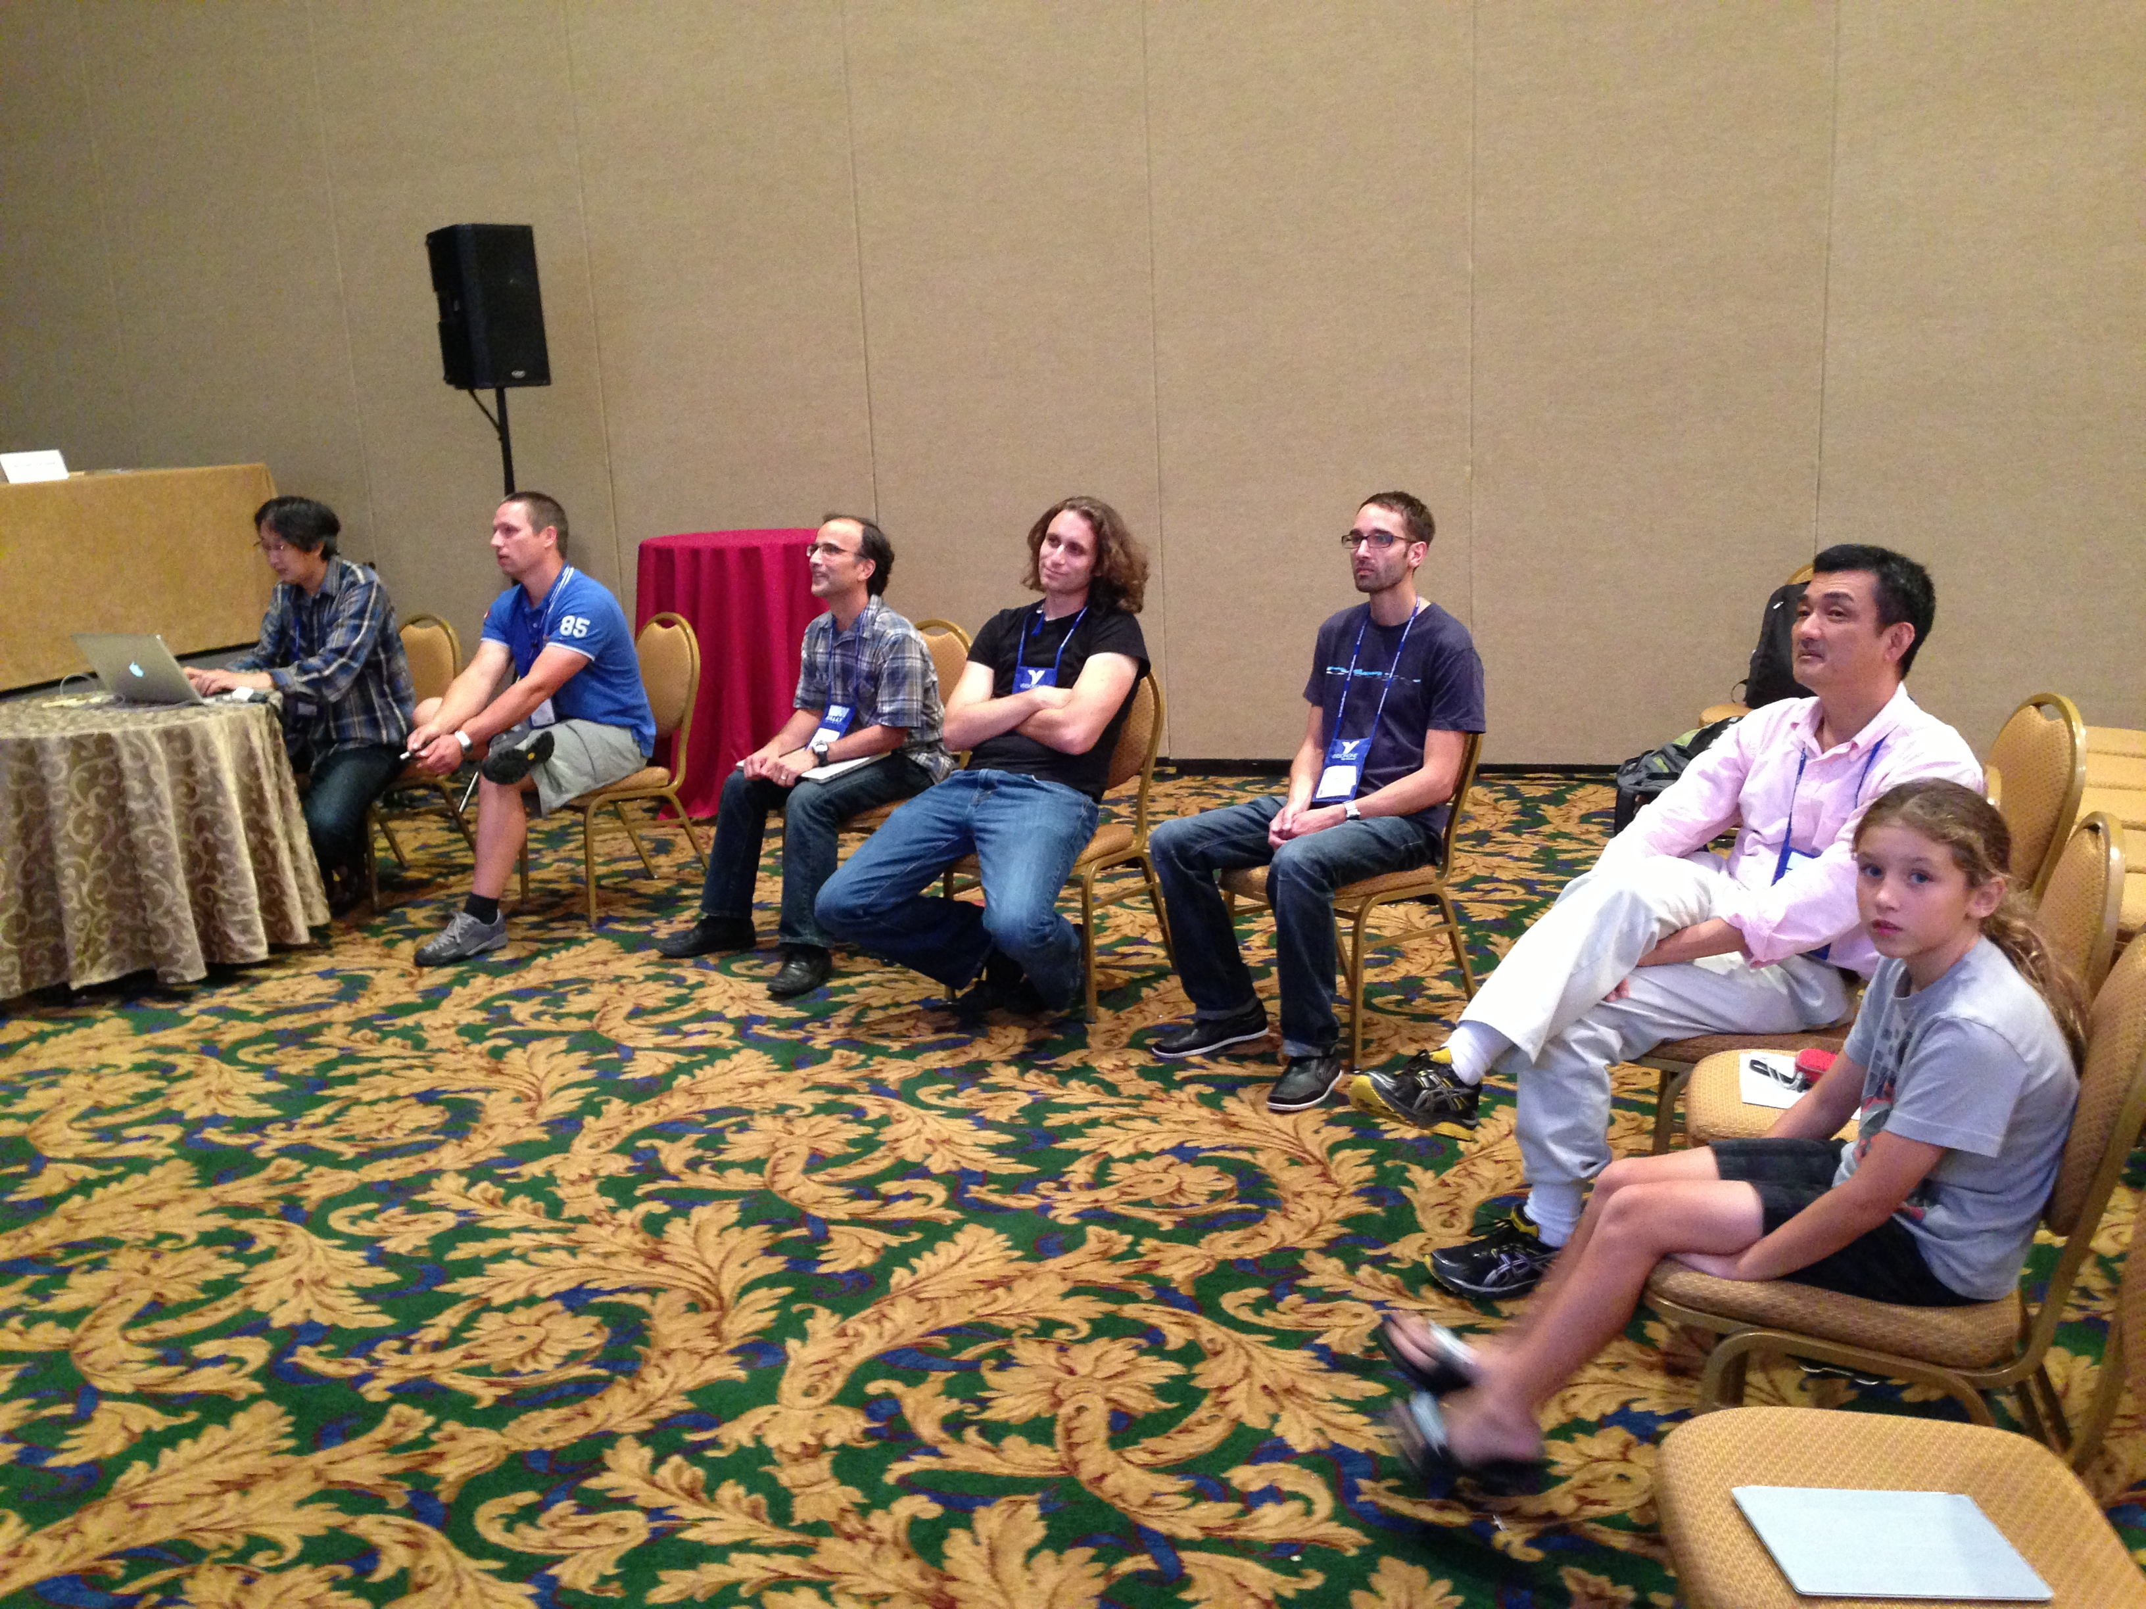

Slide 50
We are in an industry where optimizing learning is the most efficient way to work

Slide 51
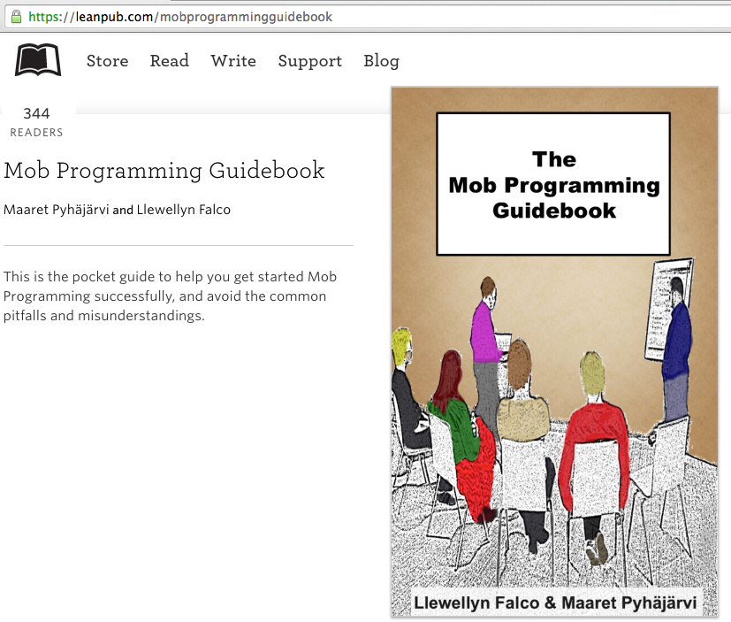
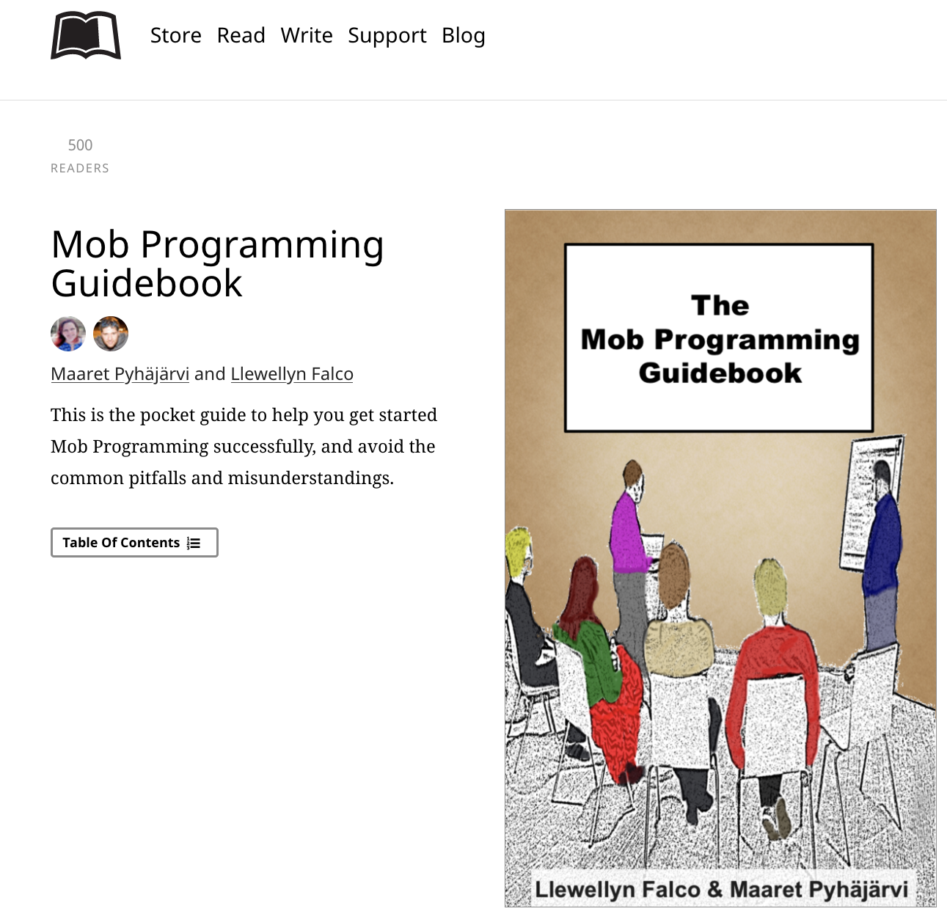
#MobProgrammingGuidebook

Slide 52
Thank you.
Slides at:
http://lfal.co/IntroToMobbing
Code at:
http://lfal.co/CodeFromGotoMob
@LlewellynFalco
(please connect through Twitter or LinkedIn)

